Slide 1
MY PERSONALITY
PRESENTER: FIZZA ZAKIR
SOFTWARE ENGINEERING
SE-B

Slide 2

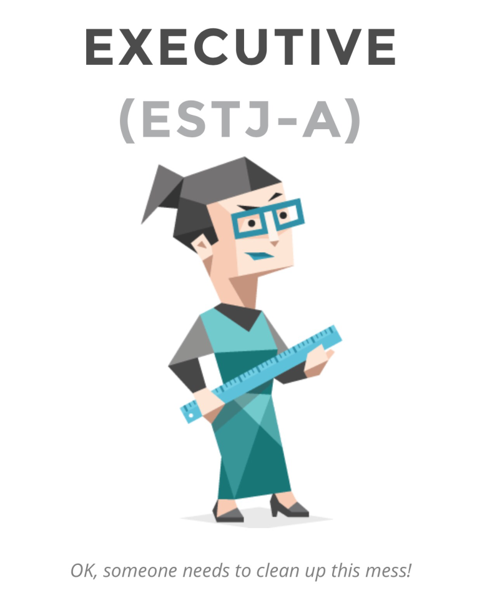
EXECUTIVE PERSONALITY :
“relating to or having the power to put plans or actions into effect”

Slide 3

WHAT IS EXECUTIVE??
Code : ISTJ
It stands for Extraverted, Sensing, Thinking, Judging. ESTJ indicates a person who is energized by time spent with others (Extraverted), who focuses on facts and details rather than ideas and concepts (Sensing), who makes decisions based on logic and reason (Thinking) and who prefers to be planned and organized rather than spontaneous and flexible (Judging)

Slide 4
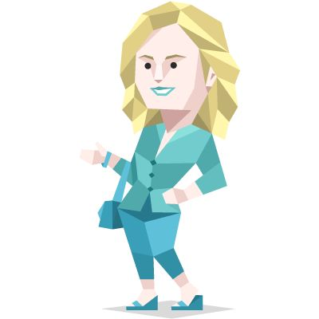
How common is the ESTJ personality type?
ESTJ is the fifth most common type in the population, and the second most common among men. ESTJs make up:
9% of the general population
11% of men
6% of women

Slide 5
FACT ABOUT EXECUTIVE PERSONALITY
Sticks Up for What They Believe Is Right...
Born with the quality of leadership
working hard to bring everyone together in celebration of cherished local events, or in defense of the traditional values that hold families and communities together
Executives are usually stubborn, but because they truly believe that these values are what make society work
Executive hate lazy and dishonest people

Slide 6
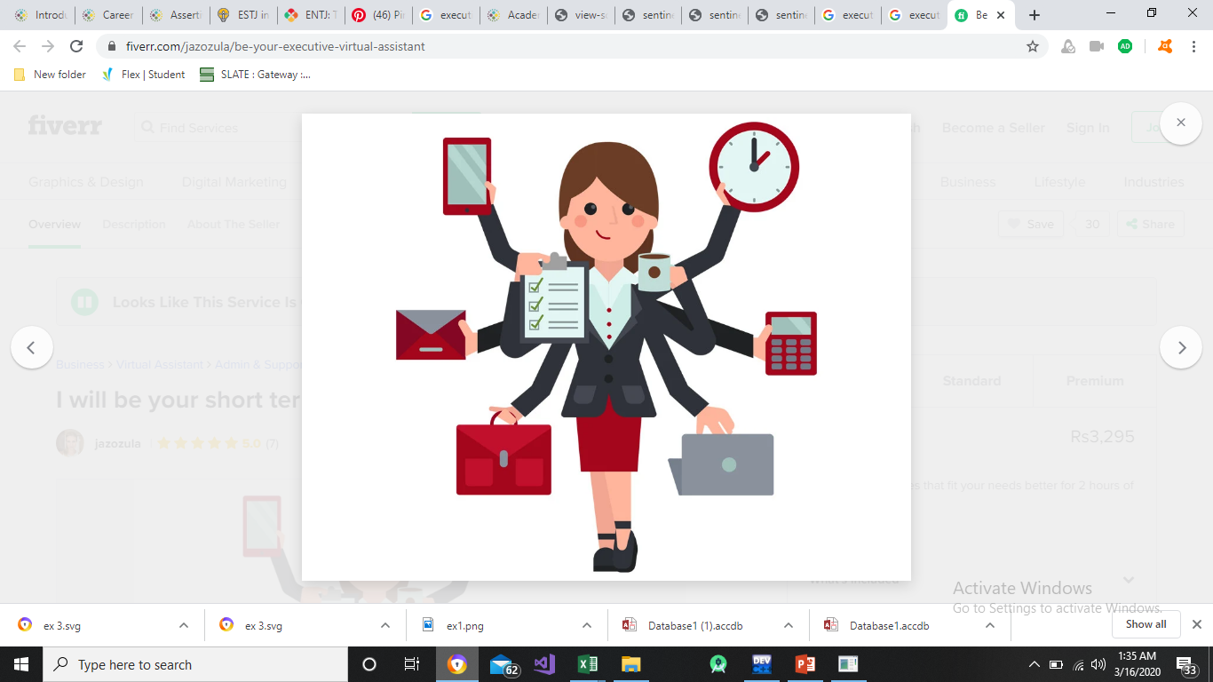
EXECUTIVE STRENGTHS
Direct and Honest – Executives trust facts far more than abstract ideas or opinions. Straightforward statements and information are king, and Executive personalities return the honesty (whether it’s wanted or not).
Loyal, Patient and Reliable-When Executives say they’ll do something, they keep their word, making them very responsible members of their families, companies and communities.
Dedicated – people with the Executive personality type take them up when they are the right thing to do, and they will be finished so long as they remain the right thing to do.
Enjoy Creating Order – Executives strive to create order and security in their environments by establishing rules, structures and clear roles.

Slide 7
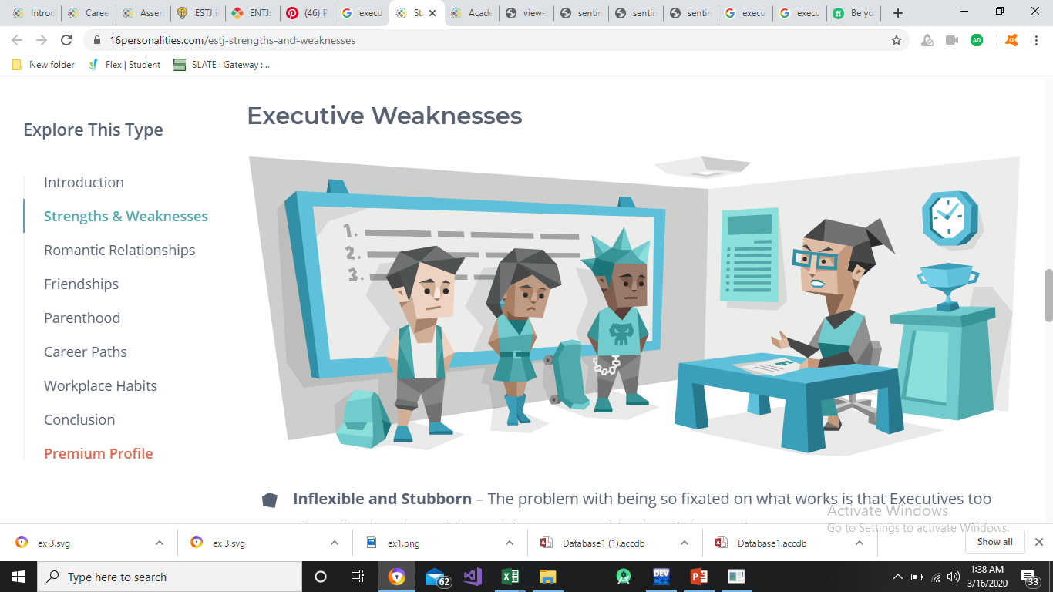
EXECUTIVE WEAKNESSES
Difficulty in Expressing Emotion
Too Focused on Social Status
Difficult to Relax
Judgmental

Slide 8
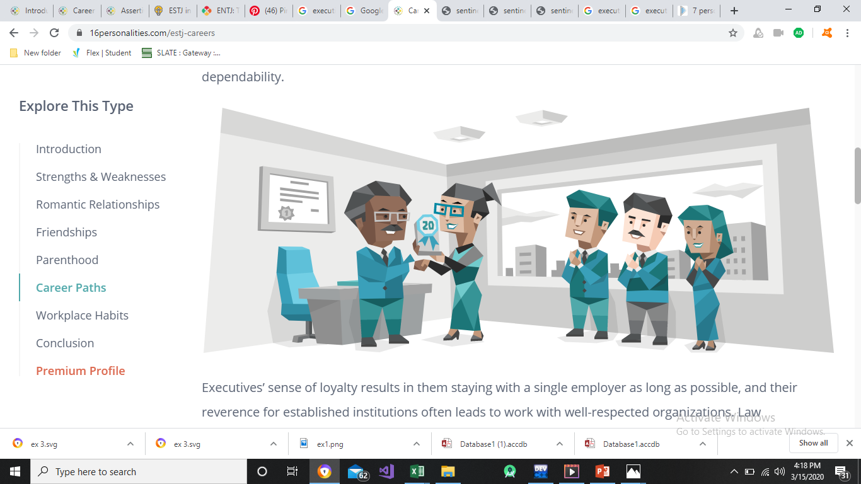
CAREER PATH
People with the Executive personality type stick to projects until they’re finished, big or small
Executives are extremely effective managers
Hard work and self-motivation are also strong Executive principles, which makes them excellent sales representatives

Slide 9


WHY I SEE MY SELF AS A EXECUTIVE??

Slide 10
THANKYOU EVERY ONE FOR GIVING ATTENTION

